Slide 1
Overview of SIFT

Slide 2
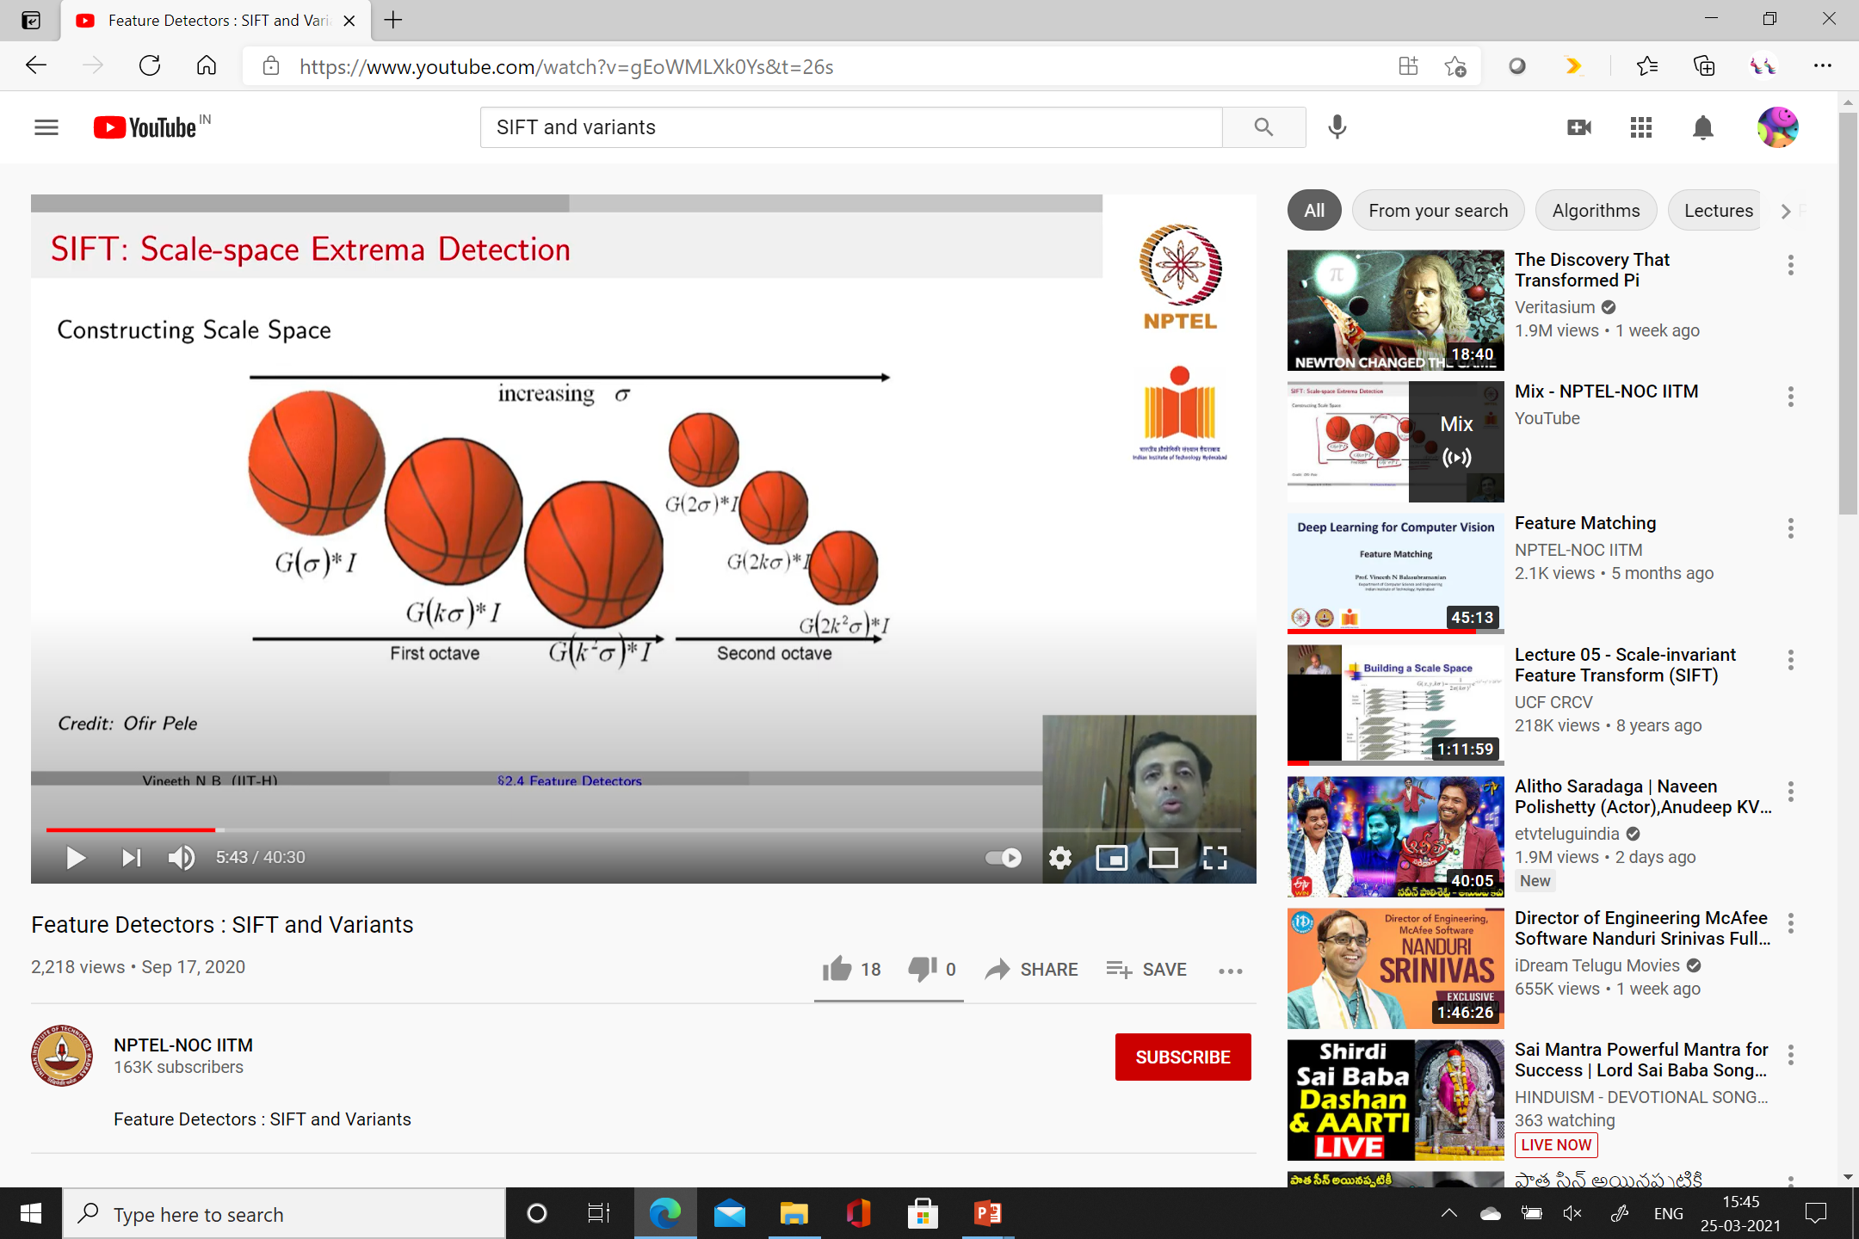
SIFT

Slide 3
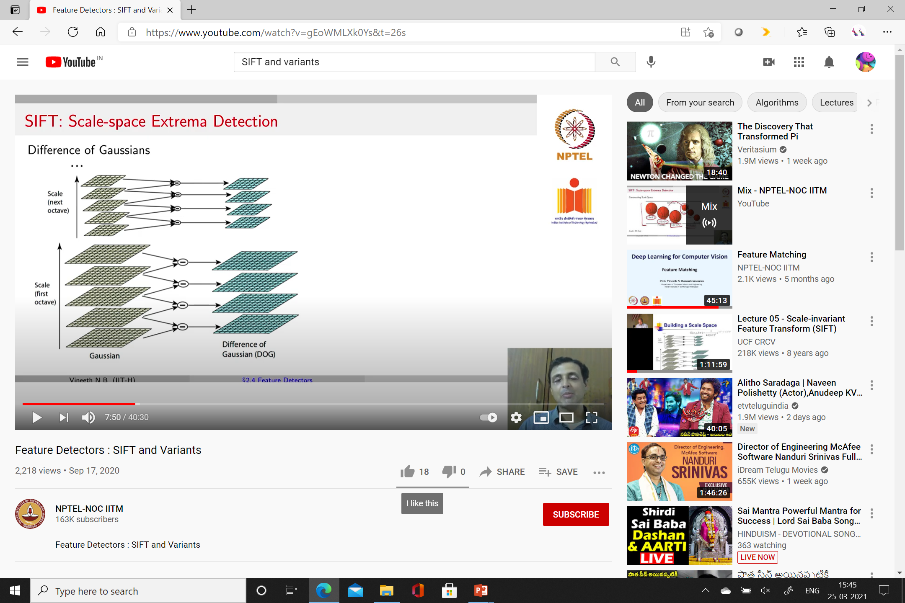

Slide 4
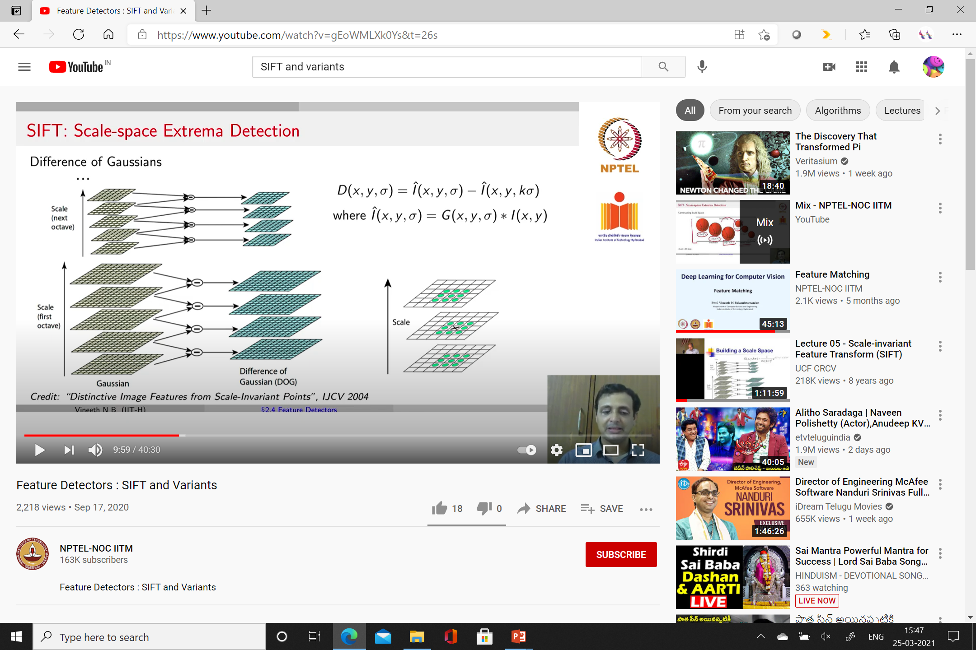

Slide 5
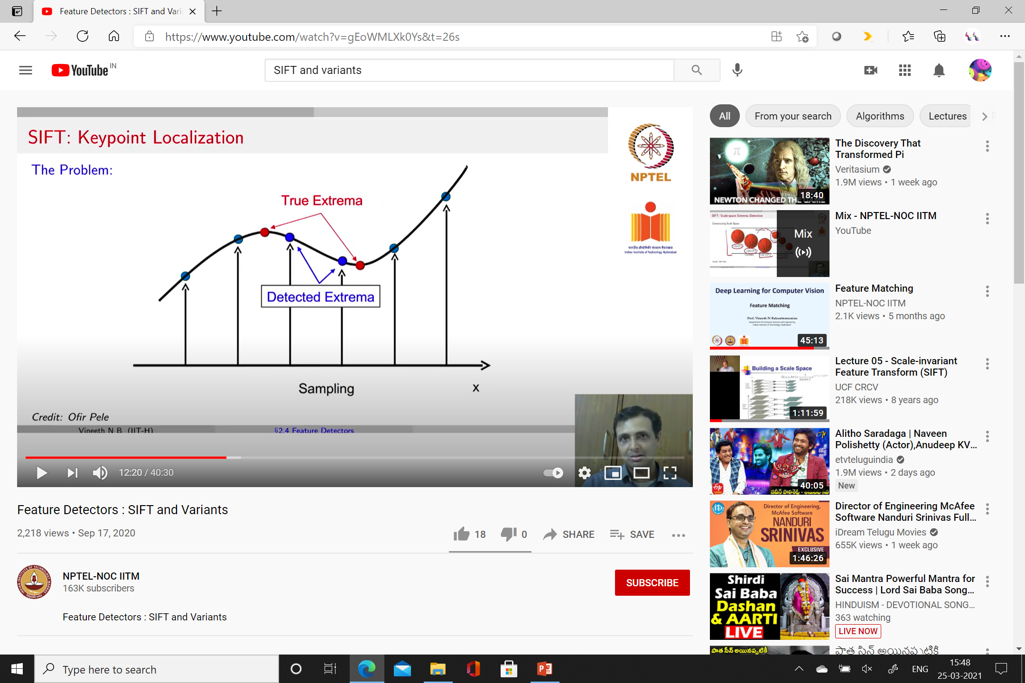
Key point localization

Slide 6
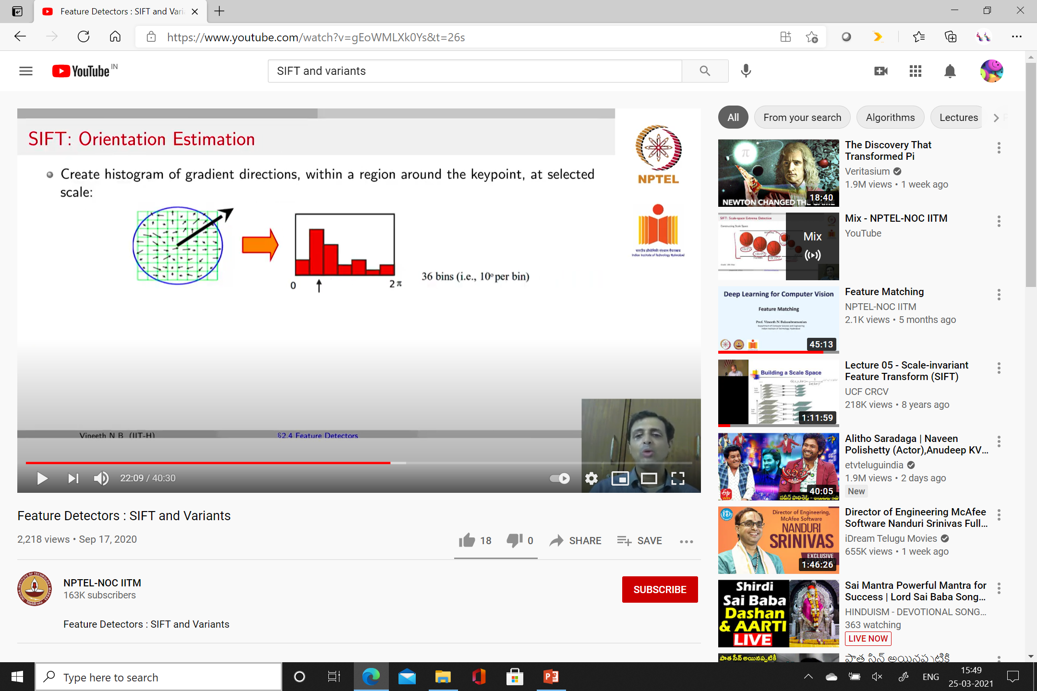

Slide 7
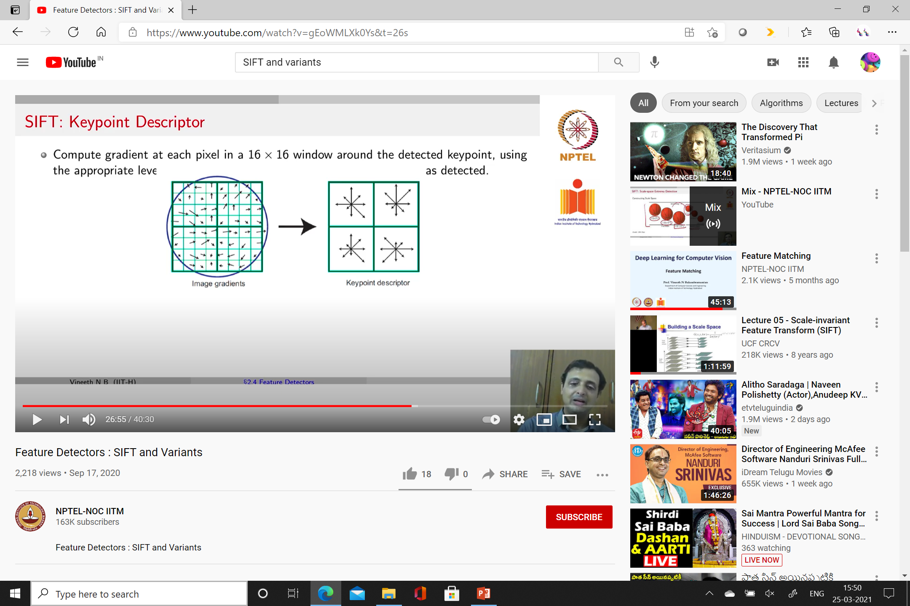

Slide 8
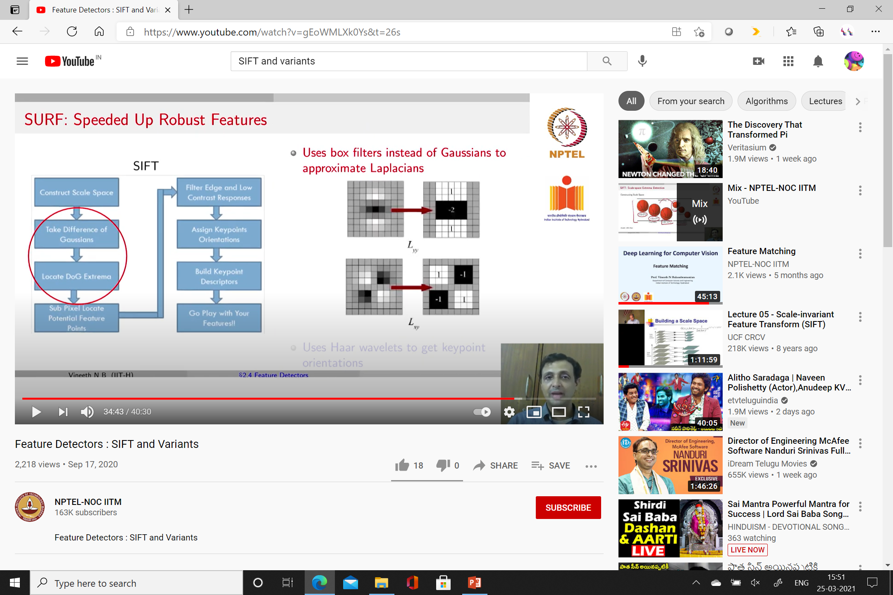
SIFT Pipeline

Slide 9
SURF
Speeded Up Robust Features
Uses Box filters
Use haar wavelets to get keypoint orientations
Simple filters – used to find gradients in x and y direction
Good in handling blur and rotational variations
3 times faster than SIFT
Considering I llumination and viewpoint changes - SURF not good
Using Haar filters – computations can be made faster

Slide 10
Box filter

Slide 11
GLOH
Gradient Location orientation histogram
Variant of SIFT
Uses log polar binning structure
Uses 17 spatial bin & 16 orientation bins
Representation – 272D histogram
Efficient – use PCA
Reduces 272D to 128D

Slide 12
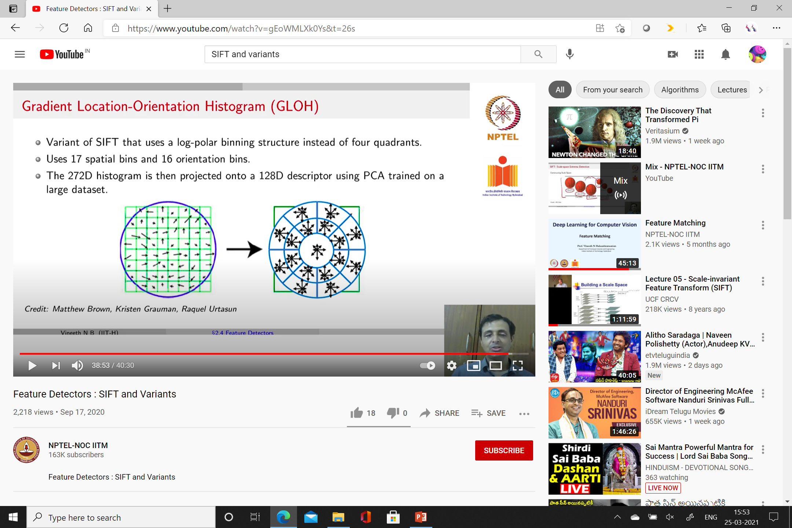

Slide 13
Image segmentation

Slide 14
Gestalt theory
One of the perspective of human vision
“The whole is greater then the sum of its parts”
Idea of grouping – understand human vision

Slide 15

Muller – Lyer illusion

Slide 16
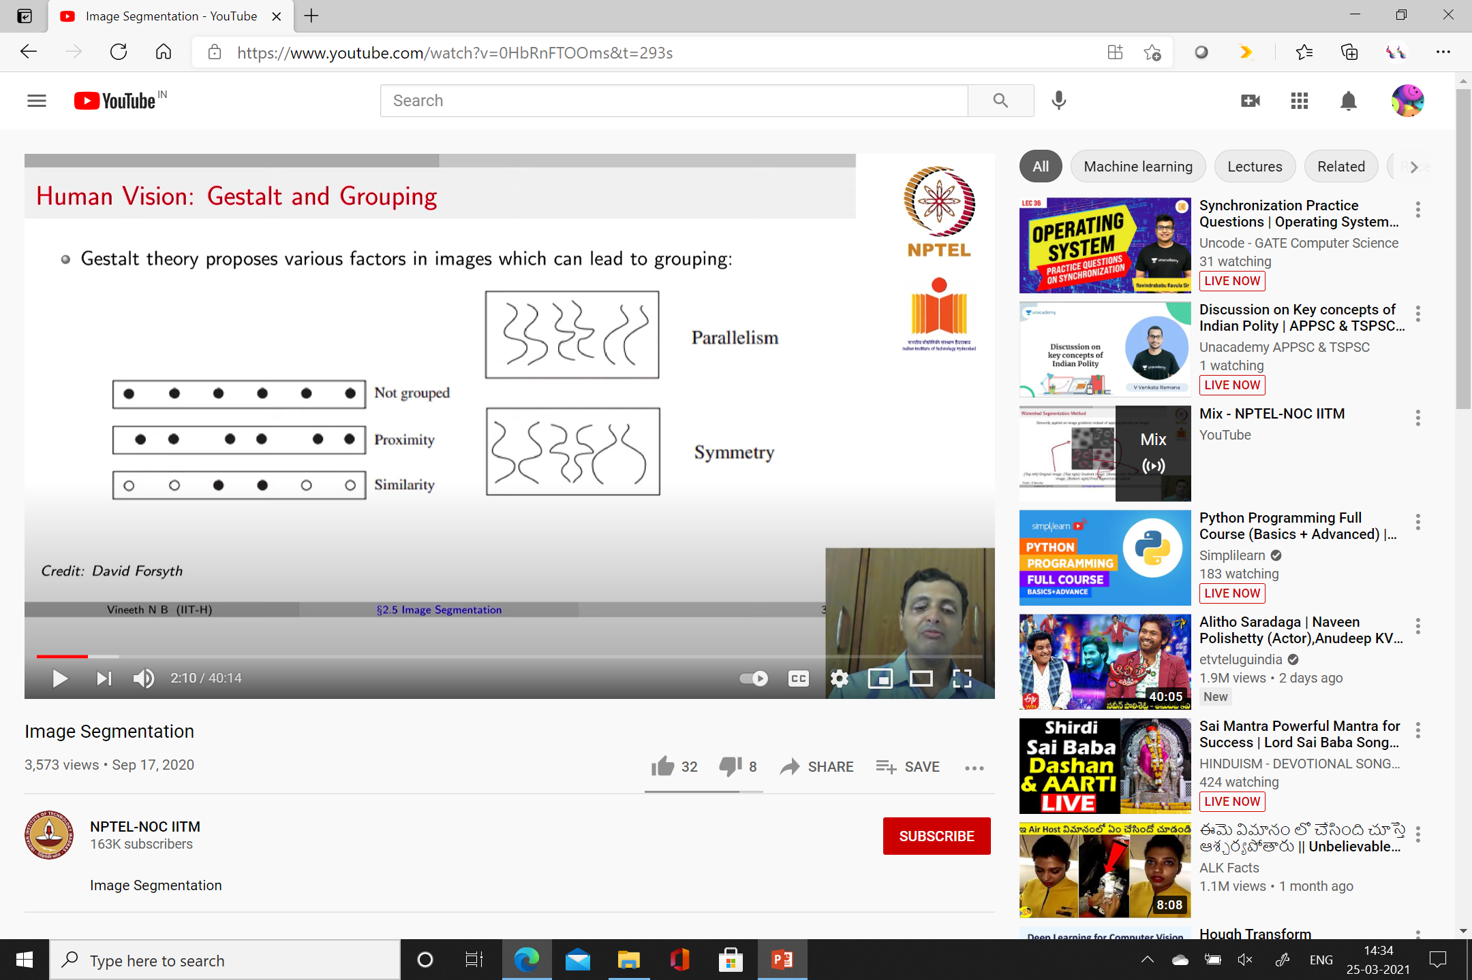
Factors – results in grouping

Slide 17
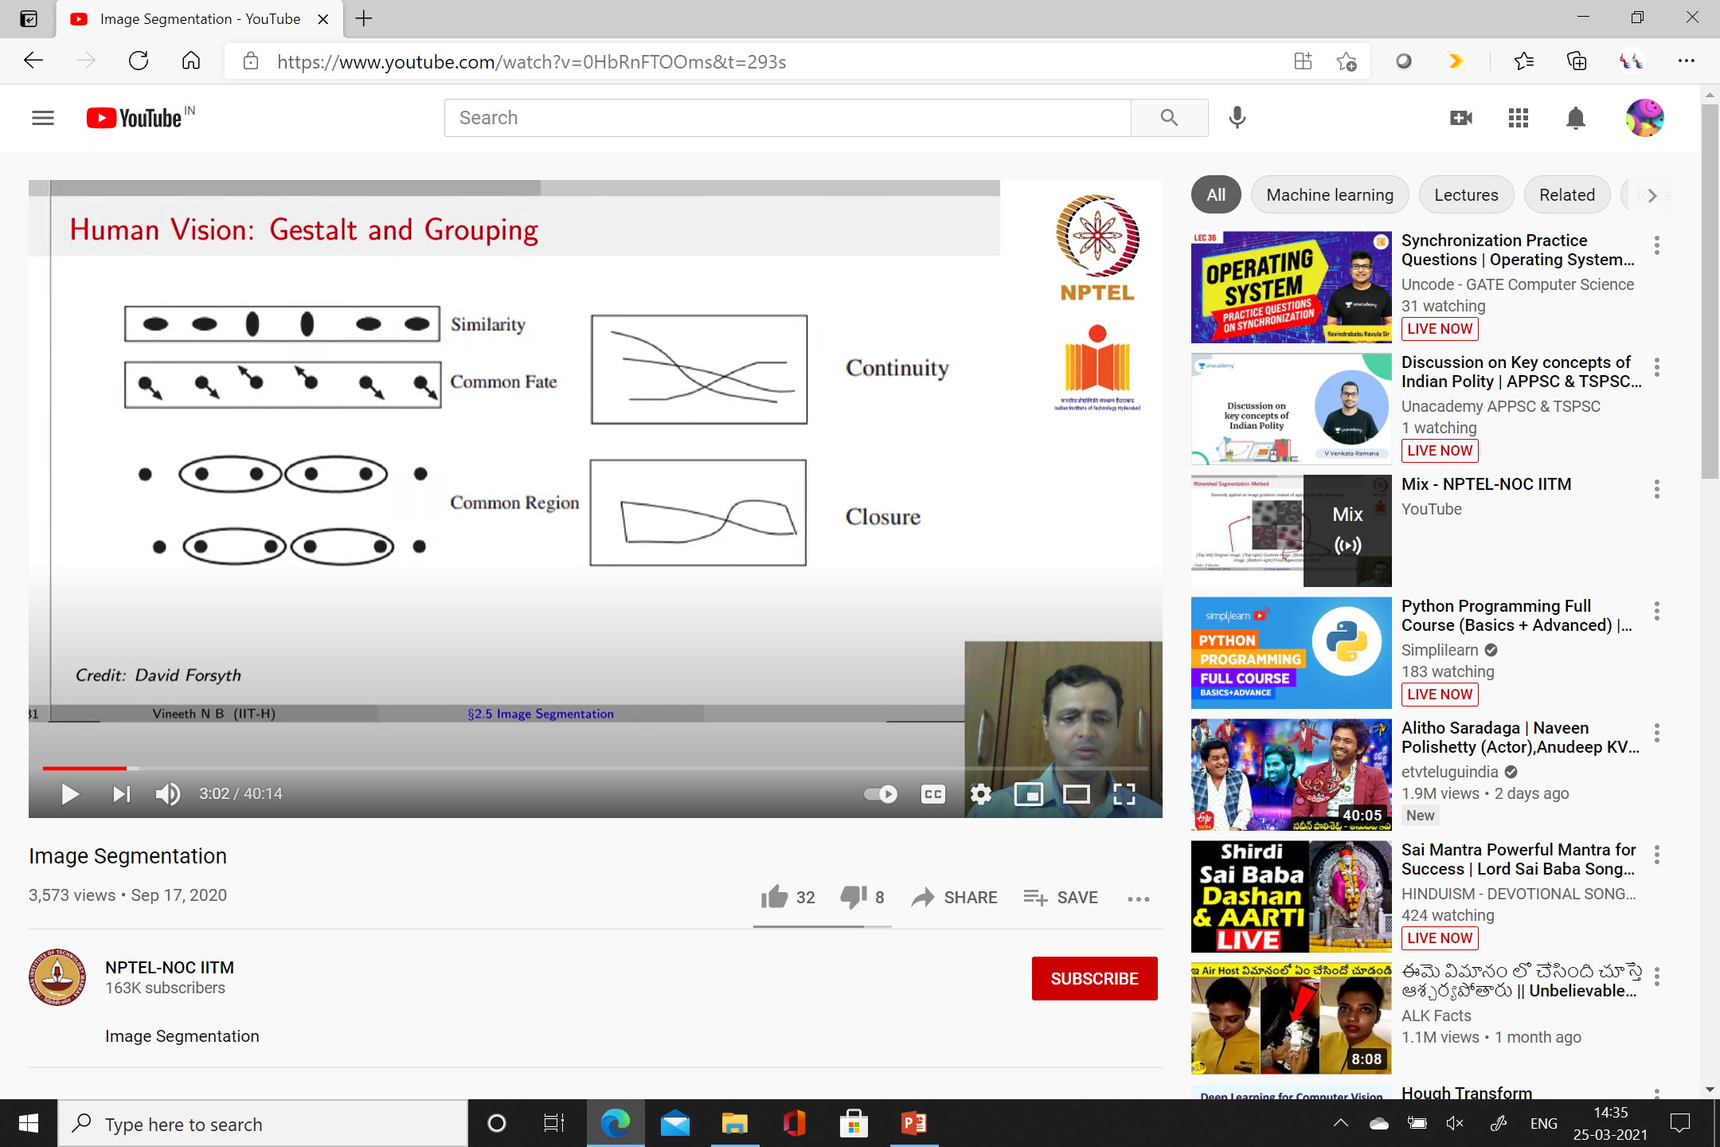

Slide 18
Gestalt theory – fairly descriptive
Rules are insufficiently defined
Clustering – Group similar pixels in to different groups

Slide 19
Region growing
Groups pixels or sub-regions to larger regions
Principle of similarity
Main segmentation criteria – homogeneity
Important characteristics – gray level, color, texture, shape, model

Slide 20
Steps
Selection of initial seed
Seed growing criteria
Termination of segmentation process

Slide 21
1 | 0 | 7 | 8 | 7
0 | 1 | 8 | 9 | 8
0 | 0 | 7 | 9 | 8
0 | 1 | 8 | 8 | 9
1 | 2 | 8 | 8 | 9

Slide 22
1 | 0 | 7 | 8 | 7
0 | 1 | 8 | 9 | 8
0 | 0 | 7 | 9 | 8
0 | 1 | 8 | 8 | 9
1 | 2 | 8 | 8 | 9
1 | 0 | 7 | 8 | 7
0 | 1 | 8 | 9 | 8
0 | 0 | 7 | 9 | 8
0 | 1 | 8 | 8 | 9
1 | 2 | 8 | 8 | 9

Slide 23
1 | 0 | 7 | 8 | 7
0 | 1 | 8 | 9 | 8
0 | 0 | 7 | 9 | 8
0 | 1 | 8 | 8 | 9
1 | 2 | 8 | 8 | 9
1 | 0 | 7 | 8 | 7
0 | 1 | 8 | 9 | 8
0 | 0 | 7 | 9 | 8
0 | 1 | 8 | 8 | 9
1 | 2 | 8 | 8 | 9
Threshold value = 4

Slide 24
1 | 0 | 7 | 8 | 7
0 | 1 | 8 | 9 | 8
0 | 0 | 7 | 9 | 8
0 | 1 | 8 | 8 | 9
1 | 2 | 8 | 8 | 9
|f(x,y) – f(x’,y’)|<=T
Threshold value = 4

Slide 25
B | B | A | A | A
B | B | A | A | A
B | B | A | A | A
B | B | A | A | A
B | B | A | A | A

Slide 26
Split and Merge algorithm
Alternate method
Image – subdivided in to arbitrary disjoined region
Consider different characteristics
Observe the discontinuity – start subdivision
Two phases
Split
Merge

Slide 27
Split & Merge Algorithm
Entire image – single region
Observe the homogeneity
If not met , split into 4 quadrants equally
Repeat the process unless the condition is met
Regions are merged – common properties are shared

Slide 28
Two Phases
Phase I : Split and continue subdivision until stopping criteria is fulfilled
Stop when no further splitting is not possible
Otherwise continue Phase I
Phase II : Merge adjacent regions if the regions share any common criteria
Stop when no further merging can be done
Otherwise Phase II is continued
Also known as “ Divide and Conquer” or “Top Down Approach”.

Slide 29
R
R1
R2
R3
R4

Slide 30
R21
R22
R1
R2
R1
R23
R24
R3
R4
R3
R4

Slide 31
R23 and R24 share common characteristic
So merging can be done
R21
R22
R1
R23
R3
R4

Slide 32
Quadtree of splitting and merging

Slide 33
Example
6 | 5 | 6 | 6 | 7 | 7 | 6 | 6
6 | 7 | 6 | 7 | 5 | 5 | 4 | 7
6 | 6 | 4 | 4 | 3 | 2 | 5 | 6
5 | 4 | 5 | 4 | 2 | 3 | 4 | 6
0 | 3 | 2 | 3 | 3 | 2 | 4 | 7
0 | 0 | 0 | 0 | 2 | 2 | 5 | 6
1 | 1 | 0 | 1 | 0 | 3 | 4 | 4
1 | 0 | 1 | 0 | 2 | 3 | 5 | 4

Slide 34
Example
6 | 5 | 6 | 6 | 7 | 7 | 6 | 6
6 | 7 | 6 | 7 | 5 | 5 | 4 | 7
6 | 6 | 4 | 4 | 3 | 2 | 5 | 6
5 | 4 | 5 | 4 | 2 | 3 | 4 | 6
0 | 3 | 2 | 3 | 3 | 2 | 4 | 7
0 | 0 | 0 | 0 | 2 | 2 | 5 | 6
1 | 1 | 0 | 1 | 0 | 3 | 4 | 4
1 | 0 | 1 | 0 | 2 | 3 | 5 | 4

Slide 35
Example
6 | 5 | 6 | 6 | 7 | 7 | 6 | 6
6 | 7 | 6 | 7 | 5 | 5 | 4 | 7
6 | 6 | 4 | 4 | 3 | 2 | 5 | 6
5 | 4 | 5 | 4 | 2 | 3 | 4 | 6
0 | 3 | 2 | 3 | 3 | 2 | 4 | 7
0 | 0 | 0 | 0 | 2 | 2 | 5 | 6
1 | 1 | 0 | 1 | 0 | 3 | 4 | 4
1 | 0 | 1 | 0 | 2 | 3 | 5 | 4

Slide 36
Example - Merging
6 | 5 | 6 | 6 | 7 | 7 | 6 | 6
6 | 7 | 6 | 7 | 5 | 5 | 4 | 7
6 | 6 | 4 | 4 | 3 | 2 | 5 | 6
5 | 4 | 5 | 4 | 2 | 3 | 4 | 6
0 | 3 | 2 | 3 | 3 | 2 | 4 | 7
0 | 0 | 0 | 0 | 2 | 2 | 5 | 6
1 | 1 | 0 | 1 | 0 | 3 | 4 | 4
1 | 0 | 1 | 0 | 2 | 3 | 5 | 4

Slide 37
Example - Merging
6 | 5 | 6 | 6 | 7 | 7 | 6 | 6
6 | 7 | 6 | 7 | 5 | 5 | 4 | 7
6 | 6 | 4 | 4 | 3 | 2 | 5 | 6
5 | 4 | 5 | 4 | 2 | 3 | 4 | 6
0 | 3 | 2 | 3 | 3 | 2 | 4 | 7
0 | 0 | 0 | 0 | 2 | 2 | 5 | 6
1 | 1 | 0 | 1 | 0 | 3 | 4 | 4
1 | 0 | 1 | 0 | 2 | 3 | 5 | 4

Slide 38
Example - Merging
6 | 5 | 6 | 6 | 7 | 7 | 6 | 6
6 | 7 | 6 | 7 | 5 | 5 | 4 | 7
6 | 6 | 4 | 4 | 3 | 2 | 5 | 6
5 | 4 | 5 | 4 | 2 | 3 | 4 | 6
0 | 3 | 2 | 3 | 3 | 2 | 4 | 7
0 | 0 | 0 | 0 | 2 | 2 | 5 | 6
1 | 1 | 0 | 1 | 0 | 3 | 4 | 4
1 | 0 | 1 | 0 | 2 | 3 | 5 | 4

